Slide 1

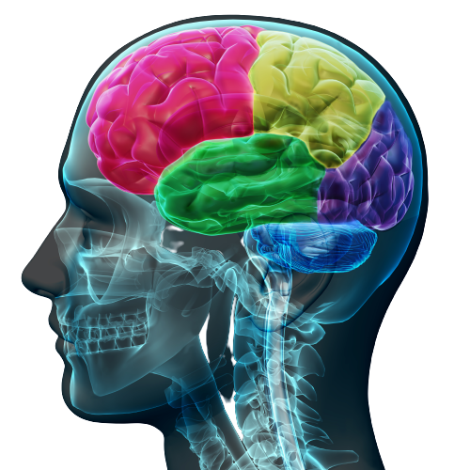
Bringing the Team EI Survey In-House Accreditation Program

Slide 2
Overall Aim
To equip you in the Team Ei Survey so you can use the survey confidently and effectively with your colleagues and clients.

Slide 3
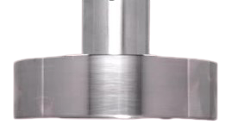
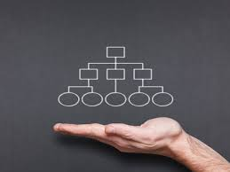
Meeting Today’s Macro Organizational Challenges through Team Development
PRESSURES
Org-wide TENSIONS
Lead to
under-performance
PRESSURES
Entrepreneurial Teams
Innovation
Entrepreneurship
Transactions/Deals
Operations/Functional Teams
Efficiency
Productivity
Performance
Pressure to Innovate
Pressure to Execute
Need to embrace Tension / Conflict to effectively Collaborate

Slide 4
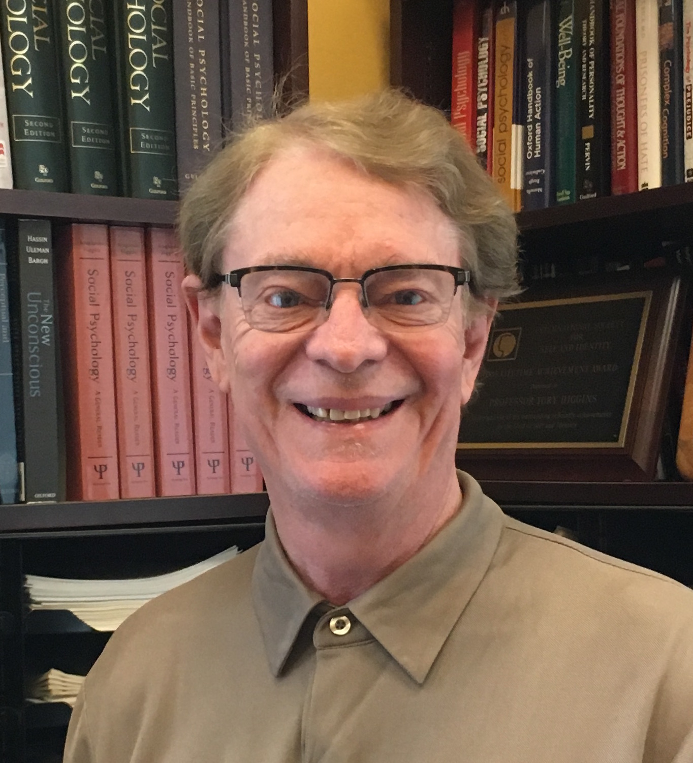
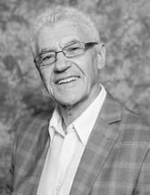
“Successfully managing conflicts between self-interests and collective interests is one of the most challenging tasks faced by teams, organizations, and governments”
-Kruglanski & Higgins

Slide 5

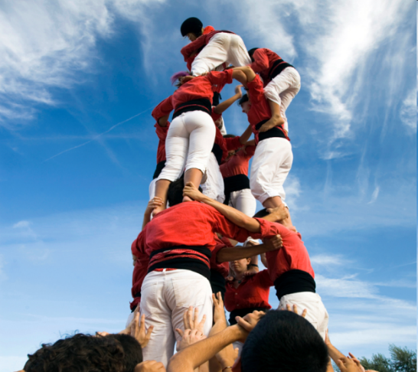
High Team Performance Today
Each person brings his/her best ideas, information, effort, and listening skills --- these are integrated to produce outcomes superior to what could have been individually produced.
Team reflection and discussion enable continuous learning and improvement.

Slide 6
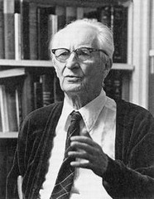
People tend not to fully recognize the role played by environmental factors in producing behavior …a person’s behavior is so vivid against the “ground” of its context that observers have no choice but to look to the person for the cause of the behavior.
-Heider

Slide 7
Fundamental Attribution Error
–a phrase used to describe the human tendency to attribute observed behavior to something within a person, while ignoring the significant influence of environmental stimuli on that behavior.
-Heider

Slide 8
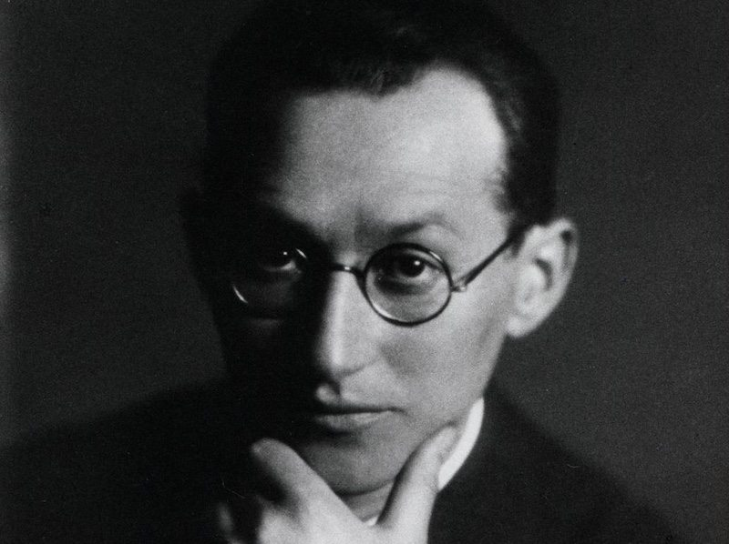
B = f(p,e)
Behaviour is a function of the person and the environment
-Lewin, 1951
The situation induces behavior
-Higgins, 1997

Slide 9
Why do people make the Fundamental Attribution Error even after they have learned about it?

Slide 10
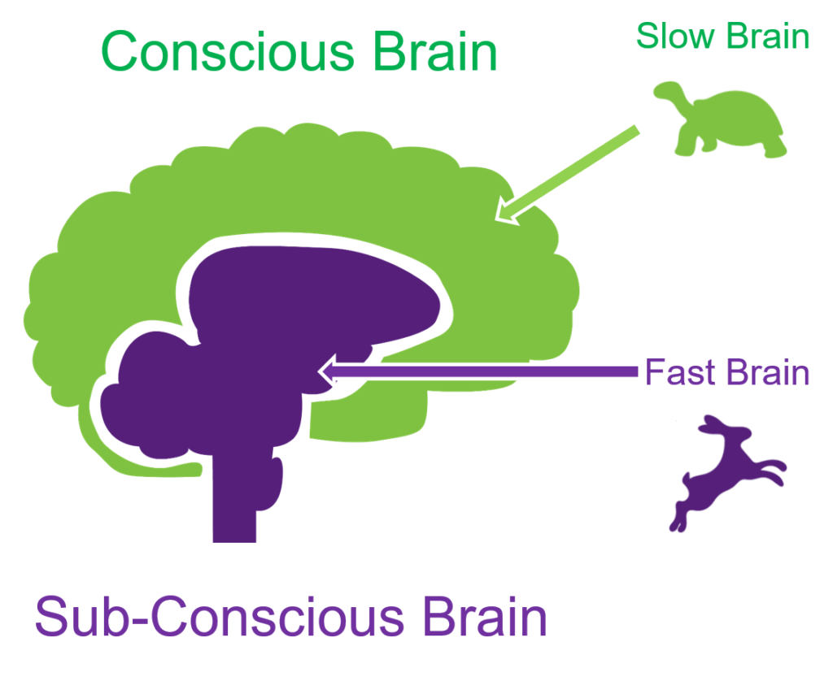

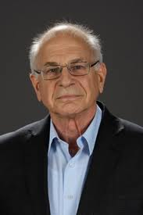
Why Emotional Intelligence (EI)?
Daniel Kahneman
Nobel Prize in Economics
System 1: fast, instinctive, emotional
System 2:
slower, deliberative, logical

Slide 11
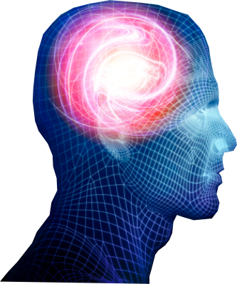
The Human Brain and Team Emotional Intelligence
prefrontal
cortex
thalamus
brain stem
amygdala

Slide 12
Emotion is at the heart of team challenges…
Conflict
  And unresolved or avoided conflict.
Disengaged members
  Who don’t participate in meetings.
  Won’t don’t perform up to standards.
  Who don’t show up.
Difficult people and personalities.
Lack of cooperation or collaboration.
Lack of trust.
Poor decisions.

Slide 13

Emotion is not Irrational
Emotion provides information.
Emotion prioritizes needs & attention.
Emotion and emotional needs are at the core of effective cooperation and collaboration.

Slide 14

Predictable Emotional Needs in Groups & Teams
Belonging (not being rejected & feeling valued).
Shared Understanding (to improve predictability).
Control.
(Fiske, 2003, 2007, and others)

Slide 15

Emotional Needs are Typically Unconcious

Slide 16
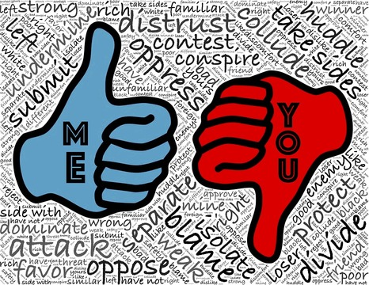



In Teams, Unmet Emotional Needs Lead to…
Selfishness
Disengagement
Poor listening
Frustrating Relationships

Slide 17
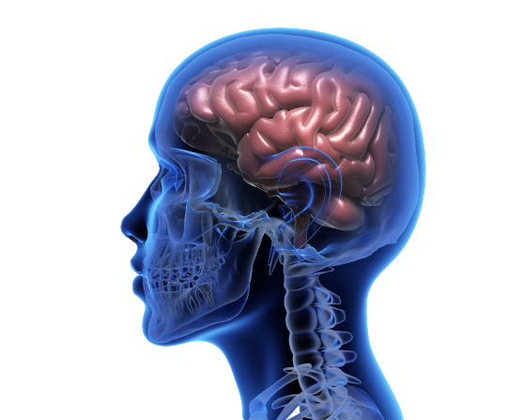
Why Teams are “Hotbeds of Emotion”

Slide 18
What is a NORM?
‘Ought statements’ that shape how members interact
They clarify Expectations and become “the way we do things here”

Slide 19
Important facts anout NORMs:
Unless enforced,
they are IDEALS not norms
High performing teams consciously develop effective norms

Slide 20
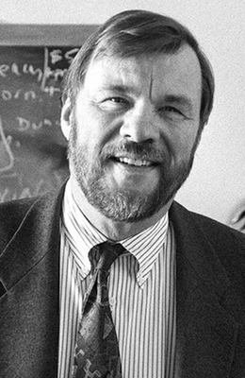


The Power of Team Norms
‘The most powerful way to build an effective team is to implement team norms (clear rules of engagement) that build constructive interactions and collaborative work processes.’
J. Richard Hackman, 2011
Edgar Pierce Professor at Harvard University

Slide 21

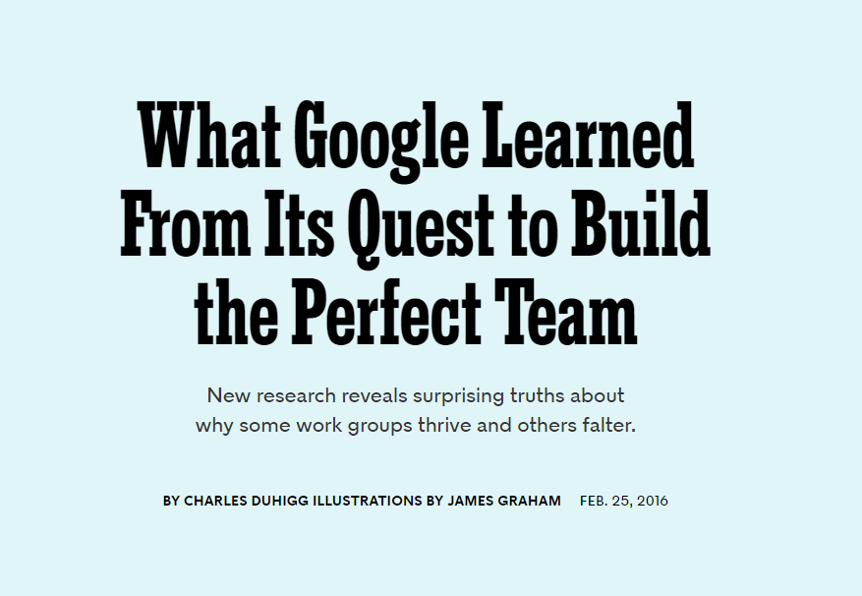
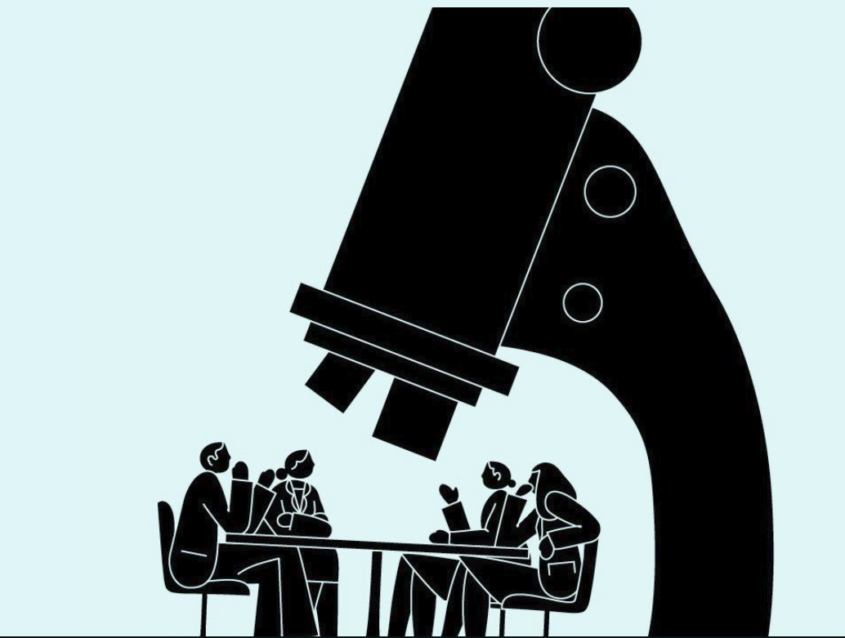

Slide 22

Definition of Team EI
A team culture created by a set of norms and expectations that build a productive social and emotional environment (e.g., trust) that leads to constructive interactions, collaborative work processes, and team effectiveness.
(Druskat & Wolff, 2012).

Slide 23

How “Team EI” Differs from “EI”
EI
  focuses on individual competencies.
  reflects individual functioning.
Team EI
  represents a culture (norms) that influences behavior and meets human emotional needs.
  reflects team functioning as a system.
  is not the sum of individual EI.
  affected by leader EI.

Slide 24
The Team EI Model

Slide 25
Team EI Framework
Team EI Levels
Team Member
Understanding Members
Managing Member Behaviour
Team
Understanding the Team
Managing Team Behaviour
External
Understanding Stakeholders
Managing Stakeholders
All influenced by team norms.

Slide 26
Team EI Norms
INDIVIDUAL
Understand Team Members
Address Unacceptable Behavior
TEAM
Review the Team
Build Optimism
EXTERNAL
Understand Team Context
Build External Relationships
Demonstrate Caring
Support Expression
Solve Problems Proactively

Slide 27
Team EI Model
3 Levels | Behavioural Norms | Evidence
Individual | Understand Team Members Address Unacceptable Behavior Demonstrate Caring | Do members understand what they need to know about each other to work together effectively? Do members address unacceptable behaviors that hurt team performance? Do members value, respect, and support each other?
Team | Review the Team Support Expression Build Optimism Solve Problems Proactively | Does the team evaluate how well it is doing? Does the team create the time and language needed to discuss difficult issues and feelings? Does the team maintain a hopeful, “can do” attitude? Is the team proactive about solving and preventing problems and avoiding a “victim” mentality?
External | Understand Team Context Build External Relationships | Does the team understand its stakeholders’ contexts and concerns? Does the team build stakeholder relationships that help its performance?

Slide 28
How Team EI Norms Build Higher Team Performance

Slide 29
How Team EI Influences Performance
Feedback Loop
Efficiency, Better Decisions, Innovation, Higher Performance
Passion, Communication, Collaboration
Trust/Psych Safety, Team Identity, Constructive Dialogue
Emotionally Intelligent Team Norms
Emergent States
Emergent States: Social Capital

Slide 30
PERFORMANCE
Team Performance Essentials
Based on the concept, research and survey of Team Emotional Intelligence
Team Social Capital
Psychological Safety
Team Identity
Constructive Dialogue
Team Emotional Intelligence Norms
Individual
Team
External
Understand Team Members***
Review the Team
Understand Team Context***
Address Unacceptable Behavior
Support Expression
Build External Relationships
Demonstrate Caring
Build Optimism
Solve Problems Proactively***
*** denotes norms which have the highest correlations with team performance
Team Fundamentals
Goals & Objectives
Meeting Processes
Roles & Responsibilities

Slide 31

Essentials for High Performing Teams
1. Team Fundamentals
        …average performance
2. Team EI Norms
        …outstanding performance

Slide 32
Summary
The Team EI Framework & Survey…
  …provide an actionable & measurable framework
  …for intentionally creating norms
  …that build a psychologically safe and performance-focused team culture
  …that drives high performance

Slide 33
Research behind the Survey
Steven B. Wolff, PhD.
GEI Partners & Ei World

Slide 34
J & J Study
Survey
33 teams with both survey data and performance data
  19 Average performing teams.
  14 High performing teams.
Qualitative Interview Data
55 Coded documents.
  12 Average performing interviews.
  43 High performing interviews.

Slide 35
Determining Breakout Performers
Nominations from upper level managers
Subjective Performance Data
Objective Performance Data

Slide 36
What we Tested
Inputs/External Support/Resources
  Team leader
  Team member skills
  Training
  Clear deliverables
  Reward/Recognition (external)
  External management support
  Culture
  Team structure (# people, is membership right, etc.)
  Shared services support
  Belief in product (external)
Group Processes
  Decision making
  Problem solving
  Conflict management
  Meeting management
  Task processes
  Use of technology
Ground Rules
  Task definition
  Measurements
  Scope and boundaries (what’s in and what’s out)
Interpersonal Interaction
  Communication (internal and external)
  Managing boundaries
  Reward/recognition (internal)
  Comfort with ambiguity
  Team Emotional Intelligence
Relationships (Social Cap.)
  Group efficacy
  Open and honest communication
  Trust and safety
  Cooperation
Group Foundation
  Role clarity
  Goals/Expectations Alignment

Slide 37
What we Found
  Team Emotional Intelligence (.403 p<.006).
  Social Capital (.329 p=.025).
  External Support (.374 p<.011).
  Team Fundamentals (.369 p<.012).
  Note: Numbers in parentheses represent the only significant correlations to performance.

Slide 38
Tangible Results
Efficiency
  Greater alignment of goals and priorities.
  “The process we used for building our team saved us months off our development time.”
Productivity
  Clear path forward on the most important tasks.
  “…in a very short time we had the noses in the same direction so we had full engagement and everyone was in the same direction.”
Innovation
  New and exciting ideas.
  “Since we understood where each team member was coming from, we were open to each others’ different ideas.”

Slide 39
Research Support – Second Study
109 Teams.
6 Companies (4 Fortune 500).
    Financial services, transportation, product design & development, industrial & consumer goods manufacturing.
Compared Group EI to Objective team performance.

Slide 40
Second Study Results
Team EI
Social Capital
Performance (25%)

Slide 41
Summary: Why Team Emotional Intelligence?
Only model for teams that addresses emotion comprehensively.
Grounded in research.
Survey tool is psychometrically valid.
Demonstrated impact.

Slide 42
Implications of Doing Business in the Digital Age
Pace of Change
  Accelerate value creation
  Adapt and Pivot
  Resilience
Complexity
  Problems are novel and more complex
  Prediction is more difficult
  Making sense is more difficult
> Collaboration
Notes:
The business environment is characterized by increased pace of change and increased complexity. Rapid change means that organizations need to accelerate value creation, adapt and pivot quickly, and be resilient. Increased complexity means problems are more complex, it is harder to make predictions, and making sense of the market is more difficult. All of these issues are lessened by highly collaborative teams. It is no longer sufficient for teams to coordinate their work to get a task done. They need to put their heads together to understand and solve problems and they need to work together and support each other to get the job done.

Slide 43
Benefits of Greater Collaboration
Improves:
  Ability to “see”
  Resilience and adaptability
  Productivity
  Ability to solve novel problems
Important Side Effects
  More enjoyable
  More productive
  Retain and attract best talent
  Innovation
> Collaboration
Notes:
Greater collaboration has a number of benefits that help teams cope with the environment in the Digital Age. Putting together multiple perspectives provides the team a richer, multi-dimensional view of the problem and its solutions. When people are working together in a highly collaborative way they are much more able to adapt. When a shift is needed they can support each other, they can put their heads together to figure out how they can adapt. These are practical outcomes but there are important side effects. In today’s environment organizations need to retain and attract the best talent. TEI makes the team environment more enjoyable and productive which is a big motivator for employees. It helps the organization attract and retain the best people. Putting multiple minds together also means that Innovation will increase. This is both in product/service and in processes. This means the team will be better able to remove obstacles that inhibit progress and accelerate value creation.

Slide 44
How Teams Accomplish Tasks
Standard Processes
Org. Environment
Resources
Skills
Conversation
Agreements
Being
Doing
Outcome
Culture
  Norms
  Mindset
Patterns of behavior
Task
Relationship
Notes:
To understand how to help teams perform at a higher level it is important to understand how they produce outcomes. There is a state of being that affects the way a team goes about its work. What the team does then produces the outcomes.

Slide 45
Where Interventions Focus
Most Interventions
TEI
Being
Doing
Doing – Being = Whack-A-Mole
Notes:
Most interventions focus on the Doing aspect of this chain. It is the easiest and most obvious way to affect outcomes. The problem with this is that the team’s Being is an important influence on what it does. The team’s Being influences whether there is conflict and tension in doing of the task. It influences how safe people feel and whether they share information. There is much written on the dysfunctions of a team but very little focuses on the underlying causes of the behaviors. There is an assumption that if you change the inputs to Doing, you will fix the dysfunction. Certainly it is helpful. The problem is that if you ignore the Being, it leads to playing a game of Whack-A-Mole. You solve one problem and another pops up somewhere else because the underlying forces causing the problem are not addressed. TEI focuses on the Being and ends the game of Whack-A-Mole. It also turns out that focusing directly on the Doing by teaching conflict resolution skills and dealing with overt conflicts is much more stressful and tense than simply dealing with the underlying Being that caused the conflict in the first place. So TEI not only eliminates Whack-A-Mole it produces results with much less emotional stress. It is like magic. Less effort, less tension, yet better results that are likely to stick.

Slide 46
How Team EI Influences Performance
Feedback Loop
Efficiency, Better Decisions, Innovation, Higher Performance
Passion, Communication, Collaboration
Trust/Psych Safety, Team Identity, Constructive Dialogue
Emotionally Intelligent Team Norms
Emergent States
Emergent States: Social Capital

Slide 47
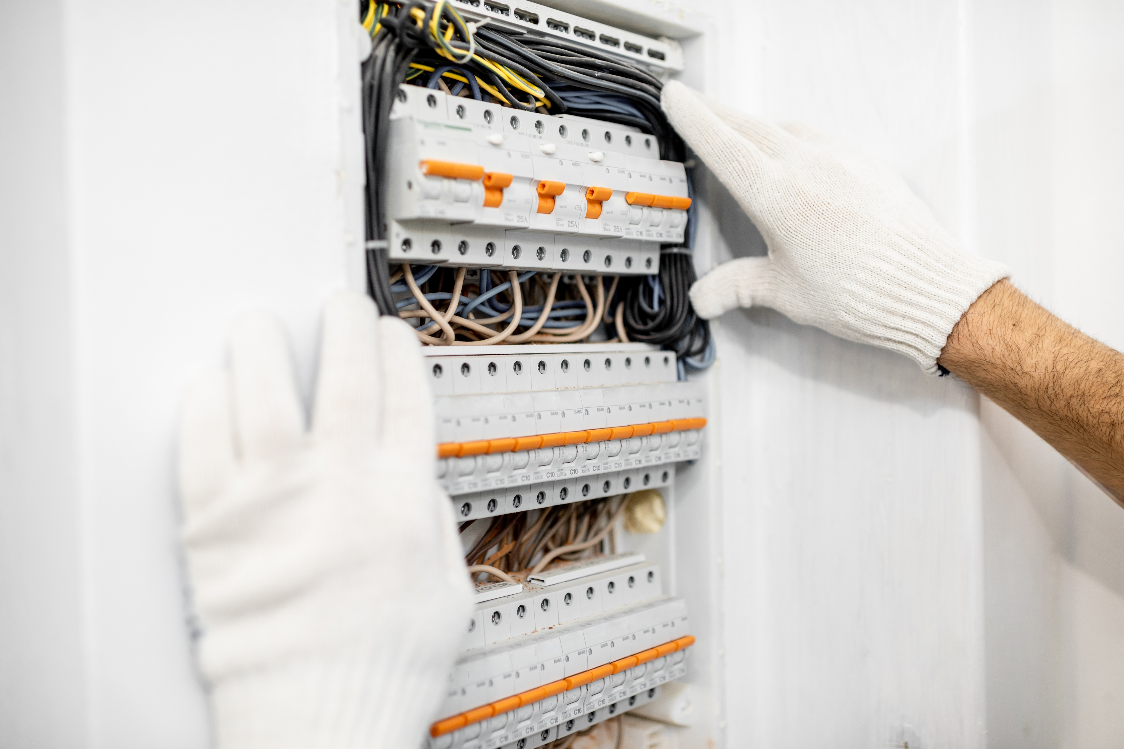
1 – Take a Systemic View

Slide 48


2 – Balance of Proactive & Reactive Tools
Which would you prefer?
Helps protect you from drowning
Thrown to you when you ARE drowning

Slide 49
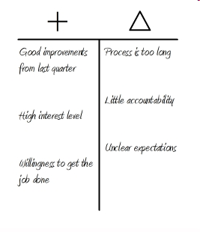


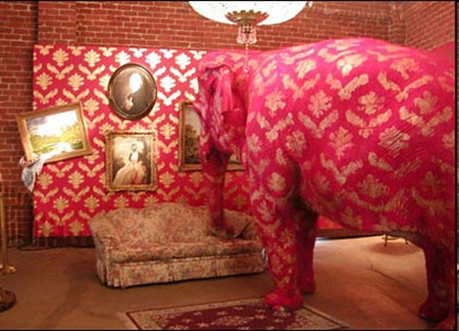
Example Tools
 | Free Whine Card
 | Elephant in the room

Slide 50

3 - Sequence

Slide 51
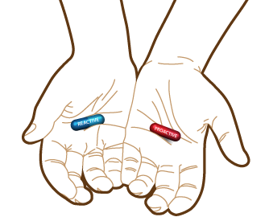
4 – Coach Resources

Slide 52
Survey Planning
Geetu Bharwaney, D.Sc.

Slide 53
Useful pages from Online Resources:
Practical Implementation
IMPLEMENTATION
    Survey project planning and logistics, including Pre-Survey Preparation
    Debriefing Survey report with Team Leader
    Survey Portal Guide and Video
COACH RESOURCES
TEAM DIALOGUE PROCESS
ENGAGING STAKEHOLDERS
    Frequently asked questions
    Sharing Experiences of Practitioners

Slide 54
Structuring a Team EI Survey Project
Engage Team Leader
Engage the Team
Team EI Survey Intervention
Initial conversation to uncover business and team context
Agree desired outcomes, scope, timelines, measures of success
Agree first step to engage with the team on the idea of team development
OPTION 1
Top down-Team Leader launches survey immediately, OR:
OPTION 2
Team coach meets team in kick off meeting, then launches survey / (Intro to concept of Team Ei can be explained now or later)
See Next Slide
Summary of what is typically involved

Slide 55
Team EI Survey Projects:
10 Key Activities
  Launch Team Ei Survey to team (time 1) once all project timelines agreed with Team Leader and with EiW.
  Read Team Ei Survey report (& expert report if requested) once generated by EiW.
  Have Phone/video Debrief of Survey Report with EiW team (optional).
  Create draft design of team session based on survey report (agenda, indicative outline for team dialogue session).
  Debrief Survey Report & review draft session outline with Team Leader (60 or 90 mins) including prep of team leader for team session.
  Send comms to team a few days before session (Report(s), session overview and preparation tasks for the session).

Slide 56
Team EI Survey Projects:
10 Key Activities
  Facilitate Team Dialogue session with Team (3-4 hours, 6 hours or 1.5 days’ duration, depending on context, budget etc).
  Provide follow up Team Coaching (options: leader, leader+1, team members; no. of sessions could be 2,3,4,6, depending on context, budget etc).
  Launch the Repeat Team EI Survey (time 2), with help from EiW.
  Facilitate 2nd Team Dialogue session to celebrate successes and plan new actions (could be half or full day, depending on context, budget).

Slide 57
Team EI Survey Projects:
Other Considerations
  Does the Team Leader need coaching? Are there components of the TEAM Ei framework you want to work through with the Team Leader before the team meets together?
  Do Team members have appetite for doing some individual exploration work, with the help of assessments, 1:1 coaching?
  Are there separate smaller groups within the team who might benefit from separate team development help? (e.g. a product team who meets more regularly than the whole team, who need to build their own norms, in order for the larger team to work well together).
  Are there multiple teams in the same organization who might benefit from having their own similar team development work, in tandem to the development work you are doing with this team?

Slide 58
Positioning the Survey and Engaging Clients
Geetu Bharwaney, D.Sc.

Slide 59
Positioning the Survey and Engaging Clients
Some key points you may want to communicate to potential users of the Team EI Survey
P.A.C.E

Slide 60
P.A.C.E in Engaging Others with the Team EI Survey
Key Question:
What does the Team EI Survey enable your organization
to do that you are unable to do
without it?
Positioning
Be clear about the key benefits of the Team Ei Survey– what it is designed to do and why this matters for your organisation.

Slide 61
P.A.C.E in Engaging Others with the Team EI Survey
Key Question:
How specifically will the Team EI Survey be used in order to reach the best outcomes for your target teams?
Application
Be clear about how the Team EI Survey is going to be used in a specific context. Recommend the best approach based on the context.

Slide 62
P.A.C.E in Engaging Others with the Team EI Survey
Key Question:
Which are the most compelling benefits of
using the Team Ei Survey?
Conviction
Be confident about the intended value-adding outcomes from using the Team EI Survey.

Slide 63
P.A.C.E in Engaging Others with the Team EI Survey
Key Question:
What is the optimal starting point for applying the power of the Team EI Survey?
Execution
Be clear about the first step to get started with the use of the Team Ei Survey.

Slide 64
Thank You!
Steven B. Wolff, PhD.
Geetu Bharwaney, D.Sc
GEI Partners & Ei World

